Slide 1

Why Did Biomechanics Start Developing

Slide 2
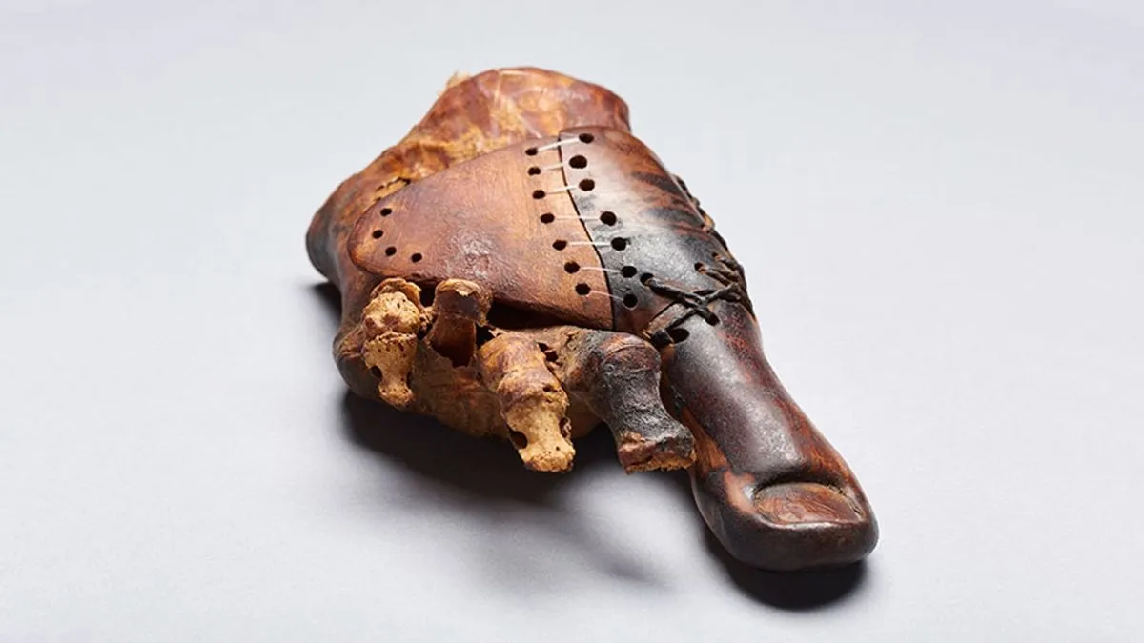
Where did it originate?
The first evidence of biomechanical research dates back to 1700 – 1600 BC in the ancient Egypt times
It was discovered that the daughter of a priest had a wooden toe to allow her to walk

Slide 3
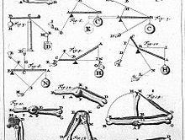
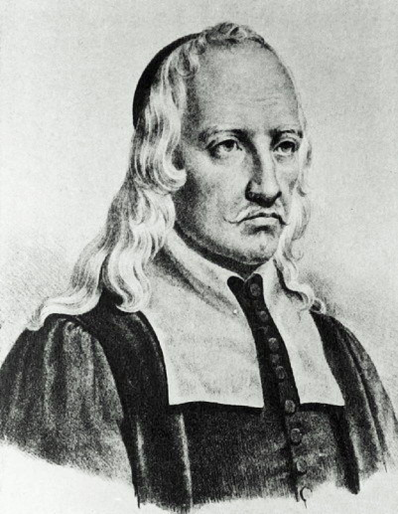
How it developed further
The development of Biomechanics was quite slow in retrospect to other fields of research.
Three Scientist made groundbreaking discoveries for Biomechanics
Giovanni Alfonso Borelli
Eduard and Wilhelm Weber

Slide 4
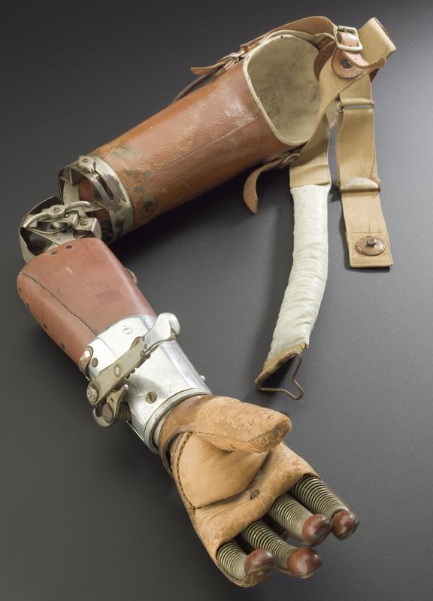
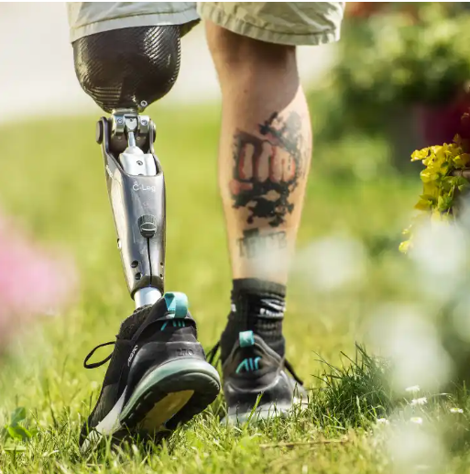
What caused a drastic change
This advancement would change the medical industry and pave a path unthought of before
Following the first World War many soldiers lost their limbs so as a way of repayment from the government money was poured into the research of prosthetic.

Slide 5

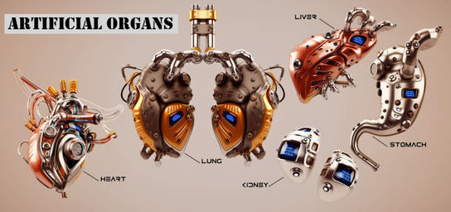
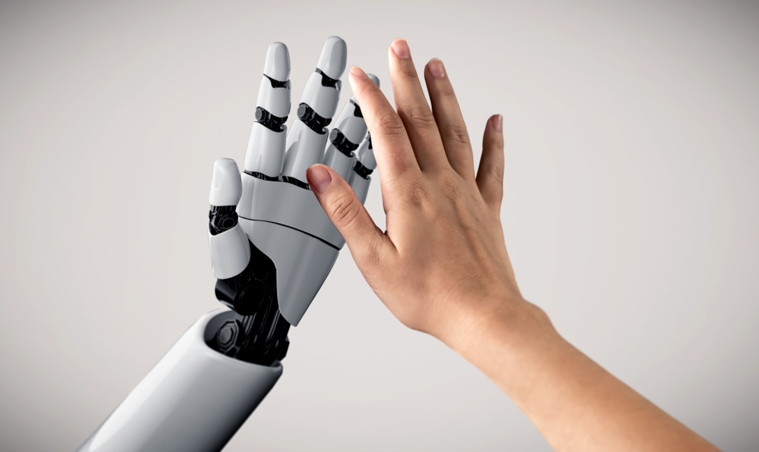
The Future
The use of AI could produce a more natural and realistic feel to the limb
Scientists aim for the creation of prosthetic organs to make organ donors a thing of the past

